Slide 1
MAR 530: Ecosystem Based Fisheries Management
Lecture 8
Aggregate and Ecosystem models
www.mycourses.umassd.edu
27 March 2015

Slide 2
Last Time…
Fisheries models
Extended single-species models
Multispecies models

Slide 3
Today’s Outline
Aggregate models
Ecosystem models
Discussion on:
Collie et al. 2014
Plagányi et al. 2014
Steele et al. 2013

Slide 4
One Main Theme Throughout Course
CONFRONTING TRADEOFFS

Slide 5
Simplified Schedule
Week | Theme | Topic
1/30 | Context | Introduction, What is EBFM?
2/6 |  | Challenges facing fisheries, what can EBFM offer?
2/13 |  | Guest lecture: case studies of EBFM
2/20 |  | Types of advice, decision theories, goal-setting
2/27 | Operational | Bycatch, habitat, and spatial management
3/6 |  | Ecosystem indicators
3/13 |  | Extended single-species and multispecies models
3/20 |  | SPRING BREAK
3/27 |  | Aggregate and system models
4/3 |  | Ecological risk assessment
4/10 | Institutional | Societal and economic considerations
4/17 |  | Governance and management institutions
4/24 | Holistic | Evaluating tradeoffs
5/1 |  | Moving towards ecosystem based management
5/8 |  | Final exam: Project Presentations

Slide 6
Major ecological models used in fisheries
Single species
Single species with add-ons
Multi-species
Aggregate biomass
Biophysical
Food web
Biogeochemical
Full system

Slide 7
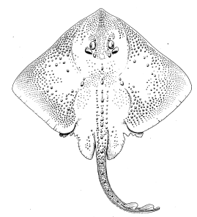
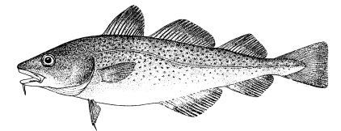
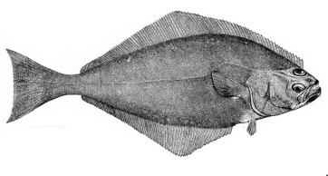
Gradient of possible tools
Stock/Single Species
Multi-species
Aggregate Biomass
Ecosystem
Messy Picture Here
Gadids
Pelagics
Flatfish
Single species models, forget ecosystem issues
food web models
Multi-species assessments
Extended single species models with predation mortality, habitat or climate effects
Whole system models
Aggregate Biomass Models
Multiple single species assessments in “harmony”

Slide 8
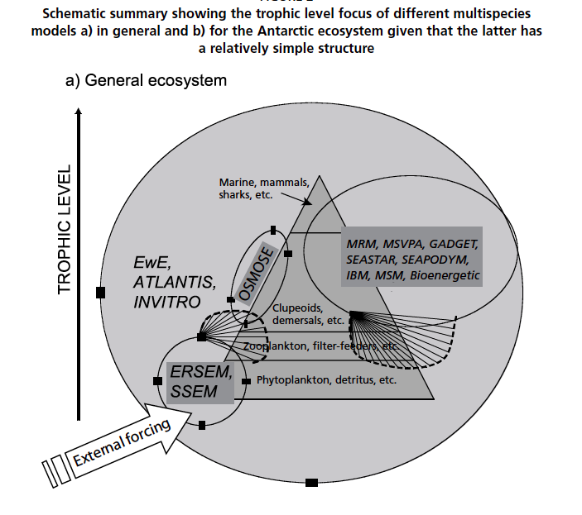
Plagányi 2007

Slide 9
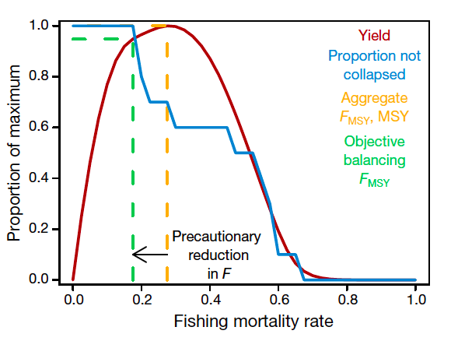
Aggregate Biomass Models in Fisheries
Intended Purpose:
Assess the status of resources as major groups (e.g. guilds, taxa), not as individual stocks.
Pros:
Establishes ability to address trade-offs among fisheries.
Model outputs are still in familiar, albeit aggregated, form.
Cons:
Minimizes stock-specific information
Assumptions of amalgamated vital rate parameters across groups of diverse species & life histories.
Data Needs:
Biomass and catch data, maybe some stomach, but clustered.
Some flows among groups
Gaichas, S., Gamble, R., Fogarty, M., Benoît, H., Essington, T., Fu, C., ... & Link, J. (2012). Assembly rules for aggregate-species production models: simulations in support of management strategy evaluation. Marine Ecology Progress Series, 459, 275-292.

Slide 10
Biomass Tradeoffs
(Brown et al. 1976, May et al. 1979, Beddington 1986, etc.)
“…the biological objective of ecosystem management must specify the species mix that is desired…” (Larkin 1996)

Slide 11
Biomass Tradeoffs
Mammals
Option 1-
Balance
Option 2-
GB Now
Elasmobranchs
Groundfish
Pelagics
Decapods & Molluscs
Junk Fish
Option 3-
Whale Hugger
Option 4-
GB 1950s
Option 5-
Rape & Pillage

Slide 12
Aggregate surplus production models
Evaluating simultaneous yield and concurrent carrying capacity type of questions
Uses existing tools, produces typical management advice: but for groups of species
Instead of B being for a particular population, consider the biomass of an aggregated group.

Slide 13
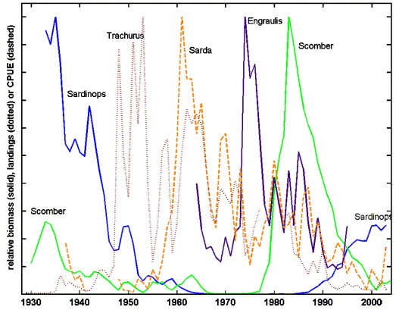
Field and Francis 2006

Slide 14
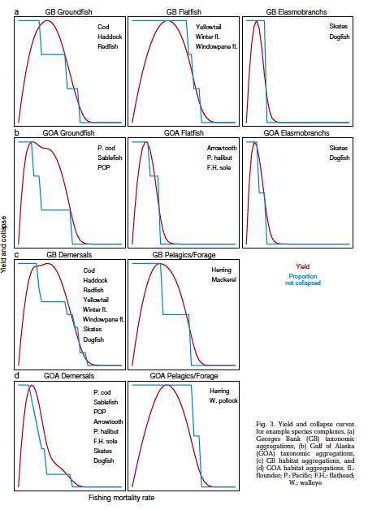
What is the appropriate level of aggregation?
Yield maximized at different levels of fishing dependent on the aggregation
Aggregate F’s can give high yields with few species collapses
Gaichas, S., Gamble, R., Fogarty, M., Benoît, H., Essington, T., Fu, C., ... & Link, J. (2012). Assembly rules for aggregate-species production models: simulations in support of management strategy evaluation. Marine Ecology Progress Series, 459, 275-292.

Slide 15
Different Aggregation Results

Slide 16
Major ecological models used in fisheries
Single species
Single species with add-ons
Multi-species
Aggregate biomass
Biophysical
Food web
Biogeochemical
Full system

Slide 17
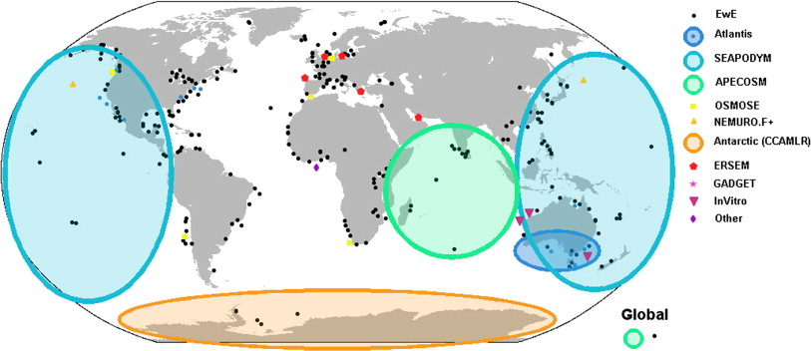
There are many examples of implemented ecosystem models worldwide
Usually for simulating / evaluating tradeoffs
Fulton 2010. Journal of Marine Systems

Slide 18
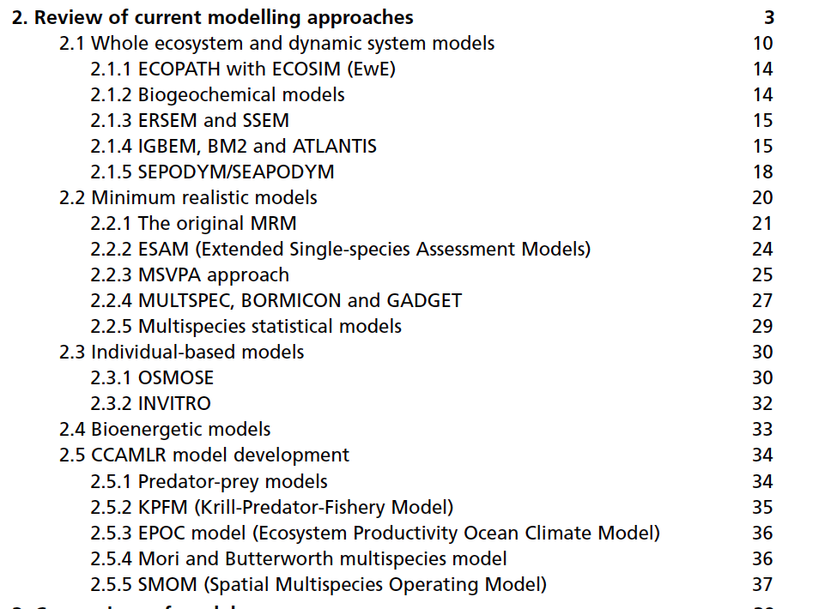
Ecosystem modeling approaches (Plagányi 2007)

Slide 19
End-to-end model types (Fulton 2010)
Qualitative (and conceptual) models
e.g. Loop analysis
Aggregate system (or network based) models
e.g. Ecopath with Ecosim (EwE)
Biogeochemically based models
ERSEM, NEMURO, Atlantis
Coupled and hybrid models
SEAPODYM, APECOSM
Agent-based models (OSMOSE, InVitro)

Slide 20
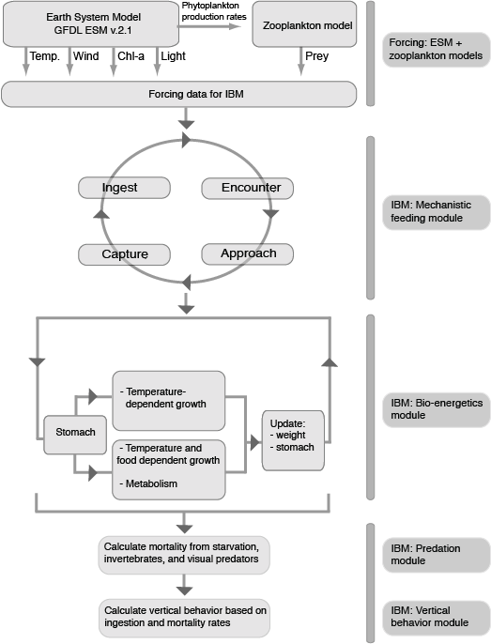
Biophysical Models in Fisheries
Intended Purpose:
Evaluate how physical conditions alter stocks
Pros:
Enhanced environmental realism
Cons:
Often uncertain or solely correlative relationship between environment and stocks
How to handle model outputs
Data Needs:
Physical oceanographic or limnological conditions
Known or estimated responses of fish to environmental conditions
Kristiansen et al. (2014)

Slide 21
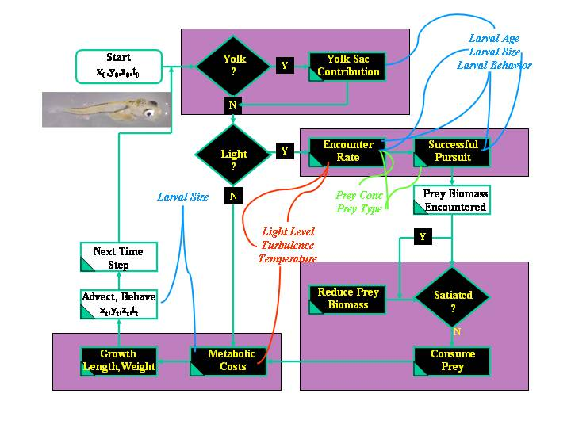
Larval Fish Trophodynamic Model
Lough et al. 2005. Fish. Oceanogr. 14:4, 241-262

Slide 22
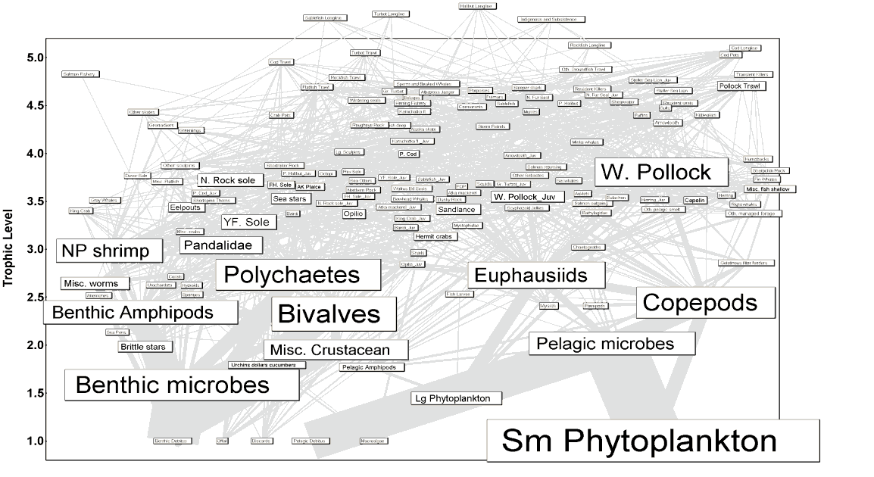
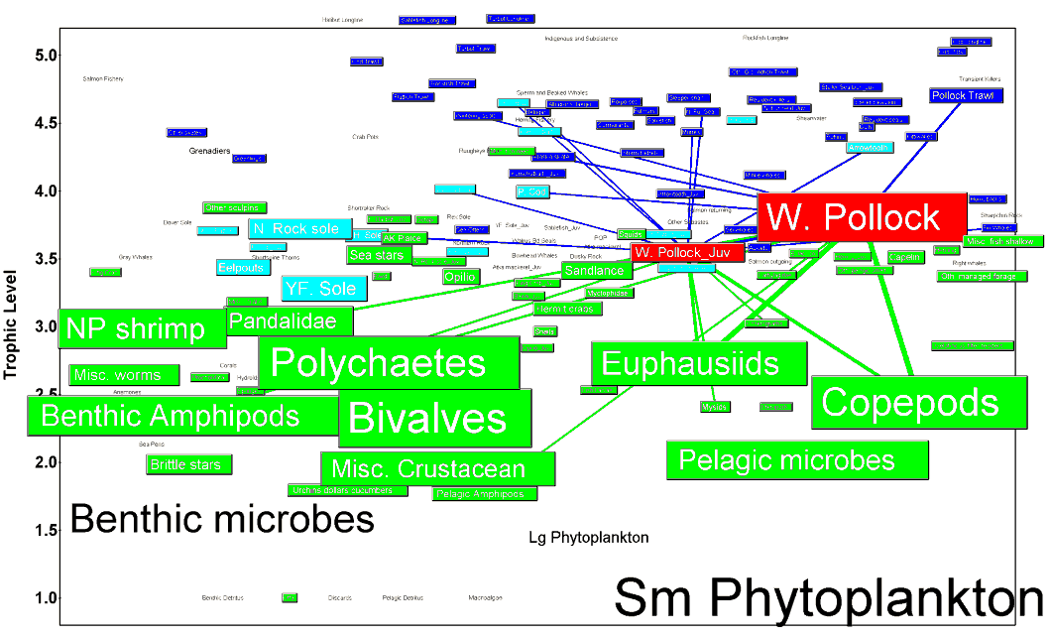
Food web models in Fisheries
Intended Purpose:
Evaluate species interactions, energy flows, and network structure of system surrounding fishery stocks
Pros:
Enhanced ecological realism
Establishes ability to address trade-offs among fisheries
Often serves as a catalog for future work
Cons:
Transparency of models
Assumptions of functional forms
Model outputs atypical for historical fisheries context
Data Needs:
Standard plus stomach, many vital rates, many more taxa than just targeted species
Flows among compartments and rates within compartments

Slide 23
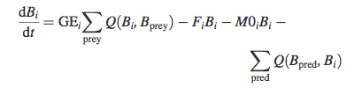
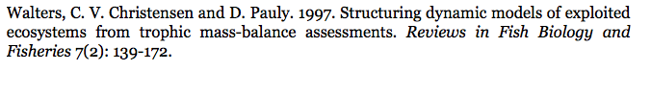
Food web, energy budget, network models
Ecopath with Ecosim (and now Ecospace)
EwE probably the most commonly applied ecosystem model in fisheries

Slide 24
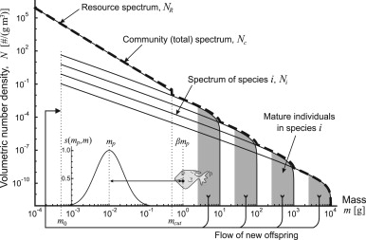
Size spectra models
Simple metabolic models
Feeding ecology based on theoretical size-based relationships
Focus on size distribution of communities rather than individual species
Hartvig et al. 2011

Slide 25
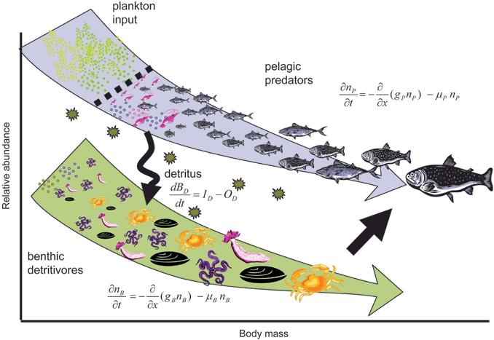
How does abundance scale with body size in coupled size‐structured food webs?
Size spectra models
Journal of Animal Ecology Volume 78, Issue 1, pages 270-280, 3 OCT 2008 DOI: 10.1111/j.1365-2656.2008.01466.x http://onlinelibrary.wiley.com/doi/10.1111/j.1365-2656.2008.01466.x/full#f1
Notes:
Conceptual illustration of two size structured communities with trophic interactions resulting in growth and mortality. The pelagic community consists of predators feeding on increasingly larger prey, as they themselves grow larger. Animals in the benthic zone share and compete for the same food: sinking detrital particles that are comprised of phyto‐detritus, faeces and dead animals. See Table 1 for equations.
© IF THIS IMAGE HAS BEEN PROVIDED BY OR IS OWNED BY A THIRD PARTY, AS INDICATED IN THE CAPTION LINE, THEN FURTHER PERMISSION MAY BE NEEDED BEFORE ANY FURTHER USE. PLEASE CONTACT WILEY'S PERMISSIONS DEPARTMENT ON PERMISSIONS@WILEY.COM OR USE THE RIGHTSLINK SERVICE BY CLICKING ON THE 'REQUEST PERMISSION' LINK ACCOMPANYING THIS ARTICLE. WILEY OR AUTHOR OWNED IMAGES MAY BE USED FOR NON-COMMERCIAL PURPOSES, SUBJECT TO PROPER CITATION OF THE ARTICLE, AUTHOR, AND PUBLISHER.

Slide 26
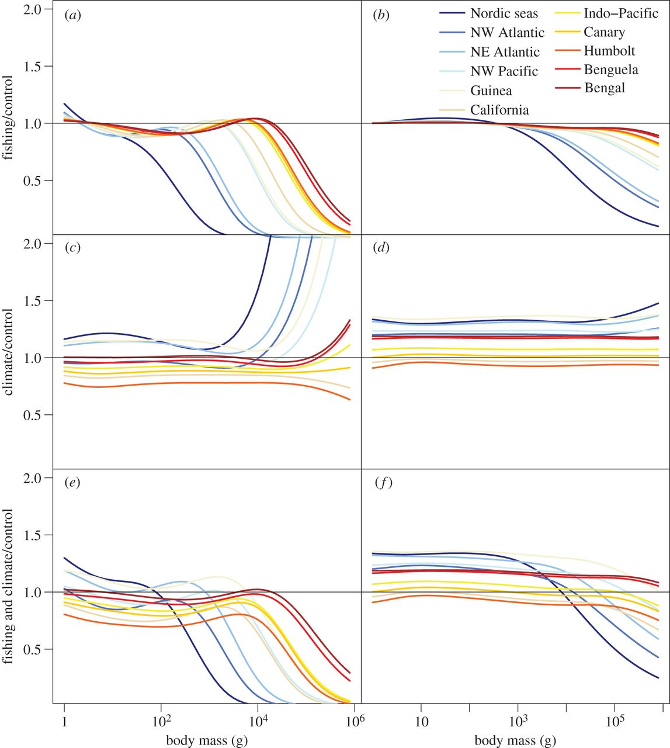

Changes in community size structure from fishing and climate.
Julia L. Blanchard et al. Phil. Trans. R. Soc. B 2012;367:2979-2989
©2012 by The Royal Society
Notes:
Changes in community size structure from fishing and climate. Changes in density at size (a,c,e) and relative growth rates at size (b,d,f) relative to unexploited control size spectra for (a,b) fishing, (c,d) climate and fishing and (e,f) climate effects. Results shown are for heavy fishing mortality rates only (0.8 yr⁻¹). Size spectra were averaged across each of the 11 large regional domains. The domains are ranked in the legend according to fish growth rates (from lowest in the Nordic seas to highest in Bay of Bengal).

Slide 27
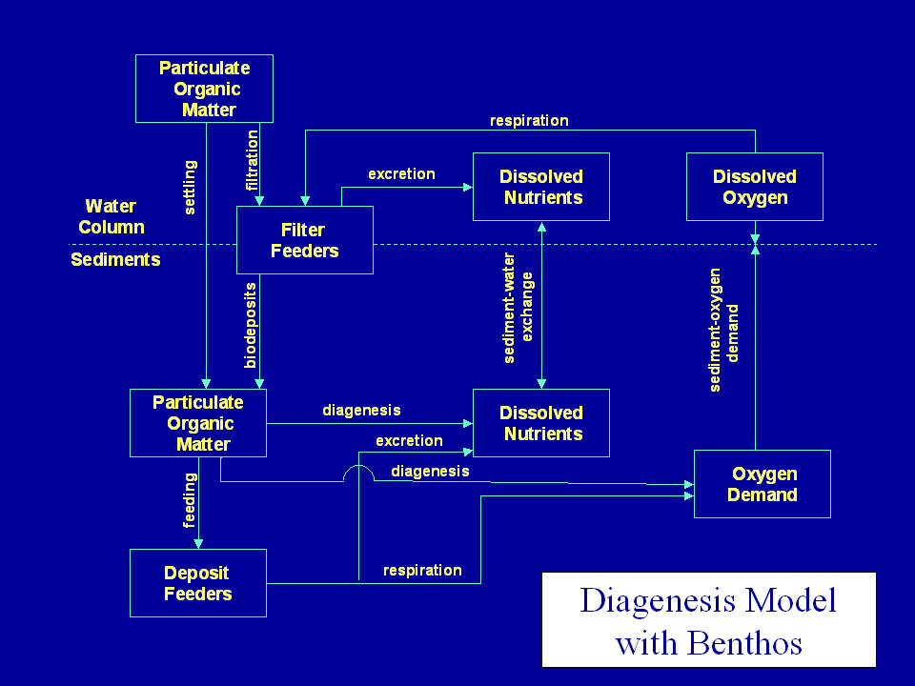
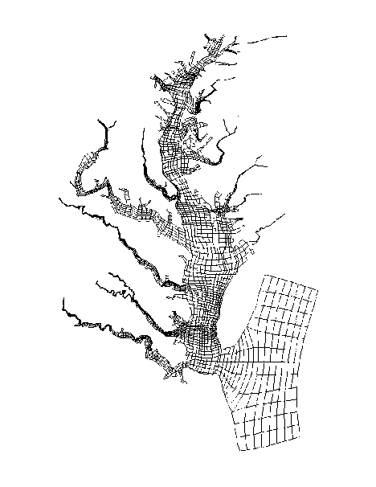
Biogeochemical models in fisheries
Intended Purpose:
Evaluate fish in the context of broader material/elemental fluxes in a system
Form the basis of some coupled ecosystem models
Pros:
Places fish in broader systemic context
Particularly helpful for chemical (heavy metal or organic toxin) accumulation modeling
Cons:
Not routinely used in typical fishery modeling contexts
Data Needs:
Elemental composition, flows among compartments and rates within compartments

Slide 28
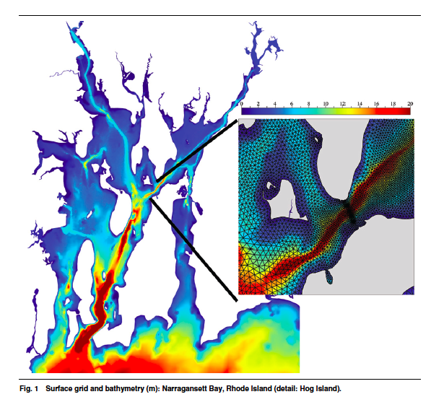
Cowles, G. W. (2008). Parallelization of the FVCOM coastal ocean model. International Journal of High Performance Computing Applications, 22(2), 177-193.

Slide 29
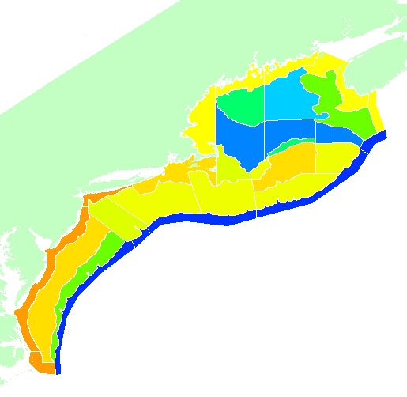
Whole-of-system models in fisheries
Intended Purpose:
Evaluate fish in context of all the potential uses of an ecosystem
Pros:
Inclusive of effectively every possible factor that can influence fish stocks
Excellent for strategic, multiple sector management
Cons:
Models quickly become unwieldy
Multiple functional forms to choose from
Model outputs may or may not be familiar
Data Needs:
Standard plus stomach, many vital rates, many more taxa groups than just targeted species
Flows among compartments and rates within compartments
Economic, socioeconomic and governance drivers
Pelagic
0
50
120+
300+
Epibenthic
Sediment

Slide 30

Atlantis – a whole of system model

Slide 31
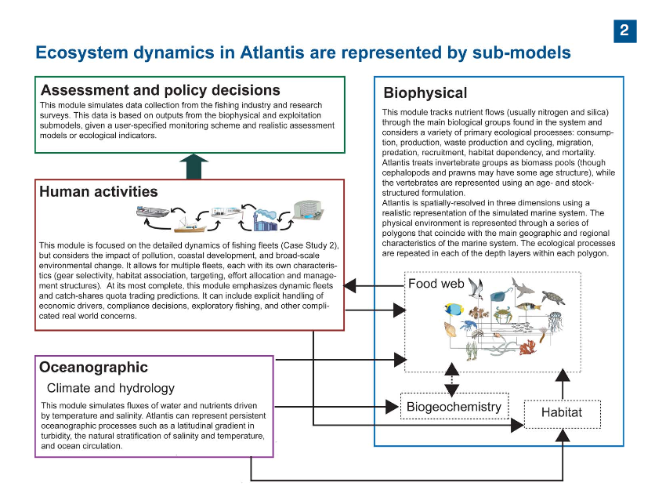
Slide courtesy of Cameron Ainsworth

Slide 32
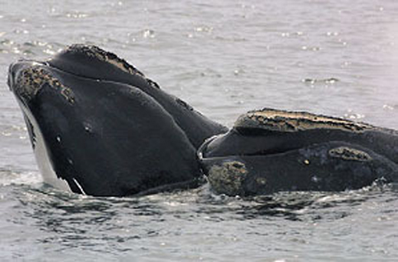


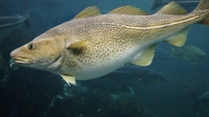
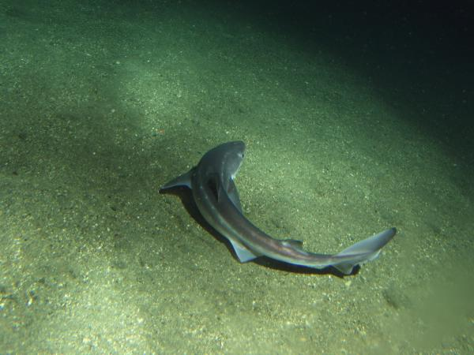
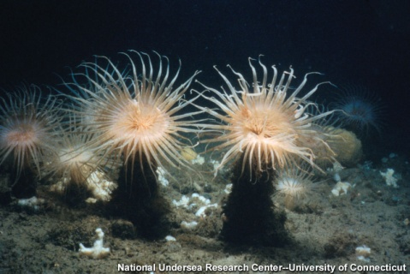
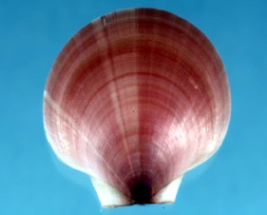

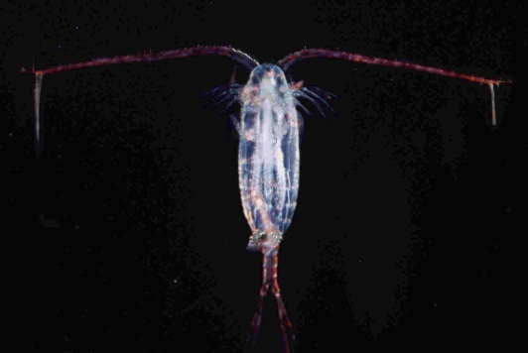
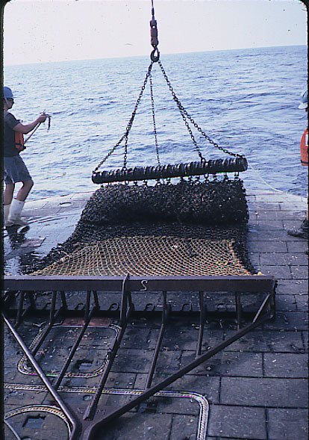
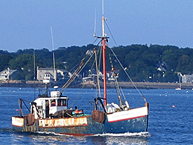
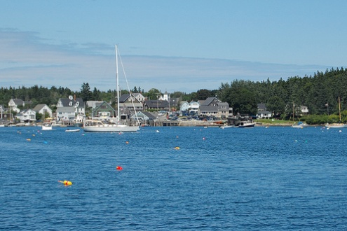
Atlantis Northeast US
Pelagic
45 Functional Groups
0
50
120+
300+
Epibenthic
Sediment
18 Fishing fleets
Link JS, Gamble RJ, Fulton EA. 2011. NEUS – Atlantis: Construction, Calibration, and Application of an Ecosystem Model with Ecological Interactions, Physiographic Conditions, and Fleet Behavior. NOAA Tech Memo NMFS NE-218 247 p. Available at http://www.nefsc.noaa.gov/nefsc/publications/.
Notes:
Quantify tradeoffs in management performance against a broader range of objectives.
Examine a more diverse suite of indicators.
Linkages to additional models.
Performance of fisheries policy options under scenarios of global change.
How to best make use of available data.

Slide 33
Atlantis NEUS – Fisheries Management
With redefined fleet as a gear x target species/group combinations: 18
Number of Management Plans, including ESA/MMPA: 32 to 25
450 possible Fishery-Plan interactions to consider, including bycatch
Average Number of Management Tools (i.e. actions/conditions/ factors) used per plan: 5-6 (none less than 3)
There are approximately 2,325 to 2,800 Fishery-Plan alternatives to track as they can affect the fisheries

Slide 34
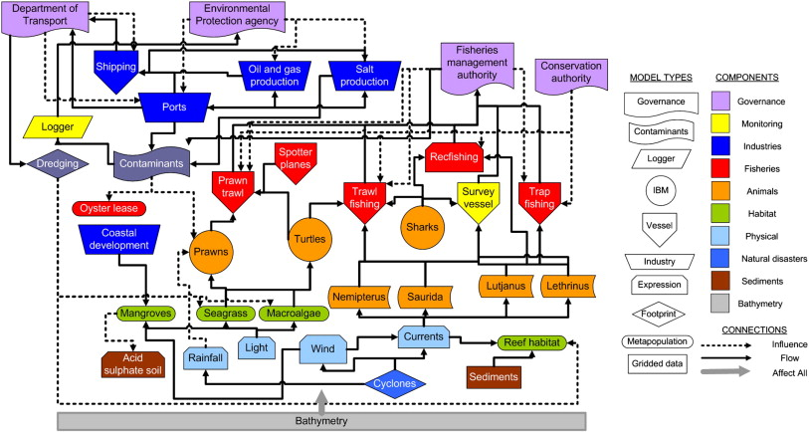
InVitro (Agent-based model)
Coupled models, aimed at evaluating multiple human uses
Fulton 2010. Journal of Marine Systems

Slide 35
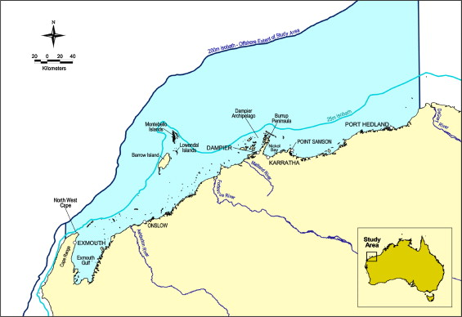
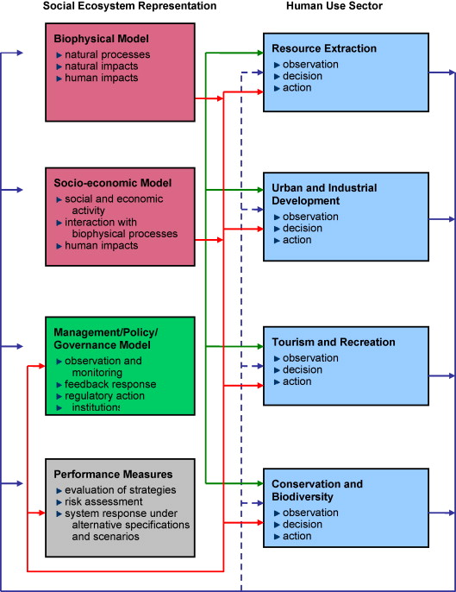
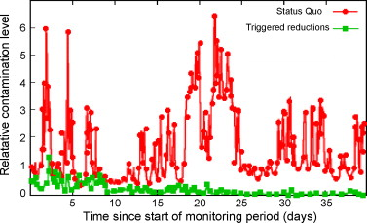
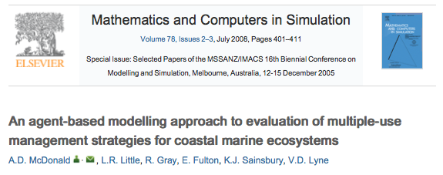

Slide 36
End-to-end models
Quantitative ecosystem models can quickly become unwieldy, output difficult to summarize and communicate.
Particularly in the model development stage, flexibility is important.
Coupled/hybrid modeling approaches have benefits of being able to stitch together existing tools, perhaps swapping model types.
Alternative approaches can include qualitative (and conceptual) models
e.g. Loop analysis

Slide 37
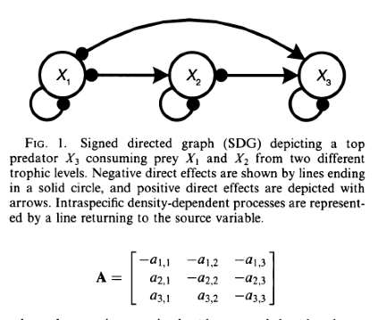
Qualitative models (e.g. loop analysis)
Intended Purpose
Characterize interactions
Assess qualitative responses
General expectations
Pros
Simple to evaluate multiple model structures
Rapid method of determining importance
Easy to understand
Cons
Hard to assign weights to links
Assume linear relationships
Hosack et al. 2008, Ecol. Appl.

Slide 38
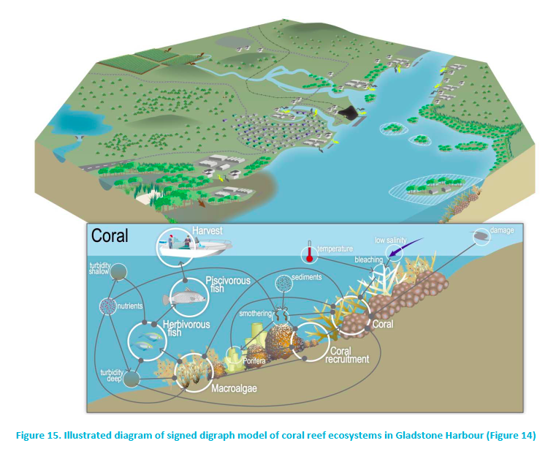
Dambacher, J.M., K.B. Hodge, R.C. Babcock, E.A. Fulton, S.C. Apte, É.E. Plagányi, M.St.J. Warne and N.A. Marshall. 2013. Models and Indicators of Key Ecological Assets in Gladstone Harbour. A report prepared for the Gladstone Healthy Harbour Partnership. CSIRO Wealth from Oceans Flagship, Hobart.

Slide 39
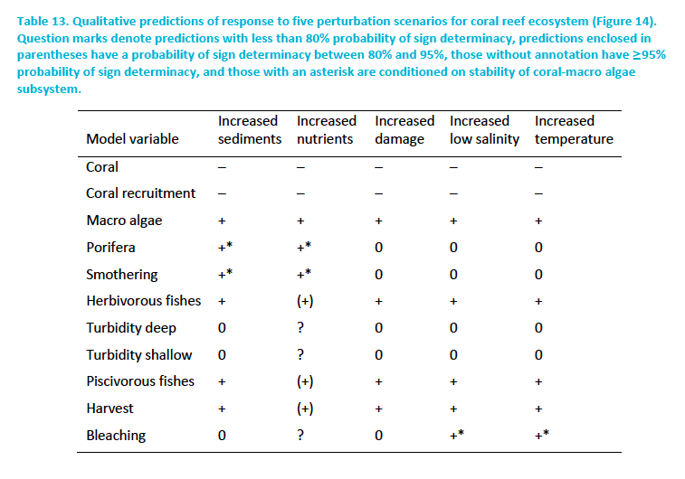
Evaluate scenarios by indicating direction of expected change
Dambacher, J.M., K.B. Hodge, R.C. Babcock, E.A. Fulton, S.C. Apte, É.E. Plagányi, M.St.J. Warne and N.A. Marshall. 2013. Models and Indicators of Key Ecological Assets in Gladstone Harbour. A report prepared for the Gladstone Healthy Harbour Partnership. CSIRO Wealth from Oceans Flagship, Hobart.

Slide 40
(Some) uses of ecosystem models
Understanding ecosystem structure and function.
Impact of target fish species on other species in the ecosystem
Effect on top predators of removing predators and prey
What ecosystem considerations need to be taken into account to rebuild depleted stocks?
Are single-species assessments biased or wrong because of a failure to include multispecies interactions?
Are there better (economic, ecological) ways to distribute fishing effort in an ecosystem?
Is fishing driving ecosystem to less productive/desirable state?
Identifying effective monitoring schemes
Expanding thinking about whole of systems (rather than simply sub-sections)
Allow for identification of new forms of adaptive management that are appropriate for changing system states.
Plagányi (2007), Fulton (2010)

Slide 41
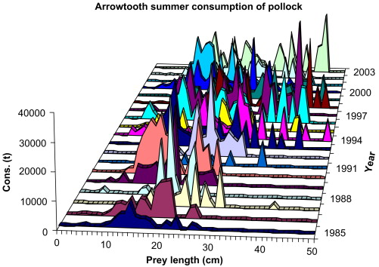
How do ecosystem components affect mortality of target species?
EwE estimates: Bering Sea
Model suggests changes in both magnitude and size class of consumption
Adyin & Mueter 2007

Slide 42
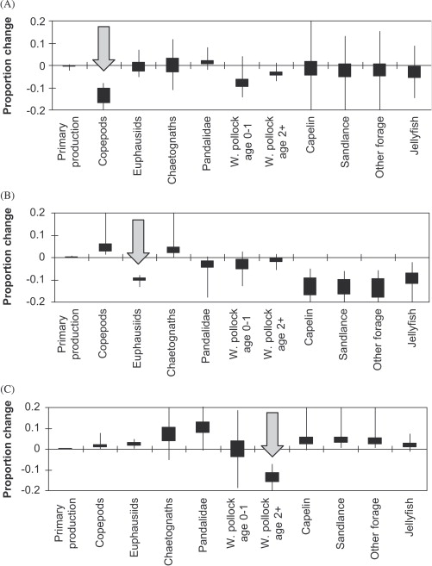
What happens when manipulate specific ecosystem components?
Adyin & Mueter 2007

Slide 43
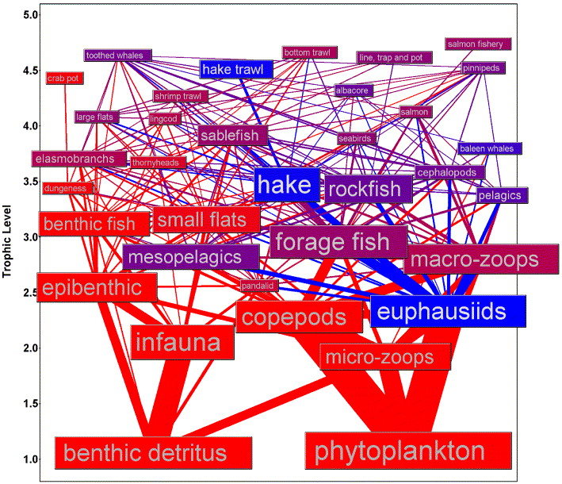
Structure and function: How is energy from one group used within the ecosystem?
Blue shows energy pathways leading from euphausiids
Field and Francis 2006

Slide 44
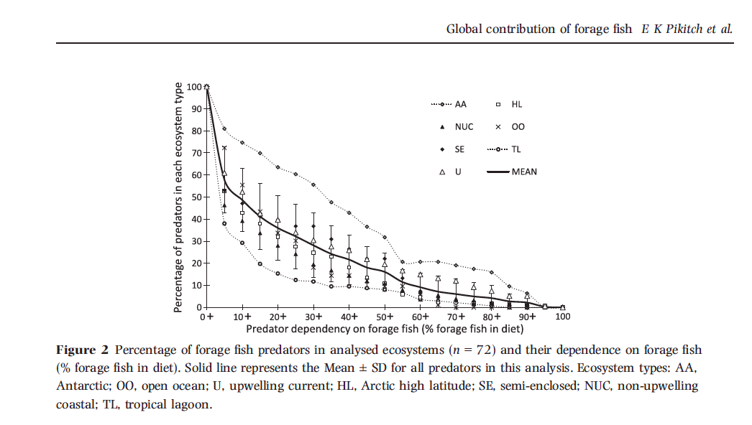
Structure and function: role of forage fish
72 Ecopath with Ecosim models, characterize dependency of predators on forage fish

Slide 45
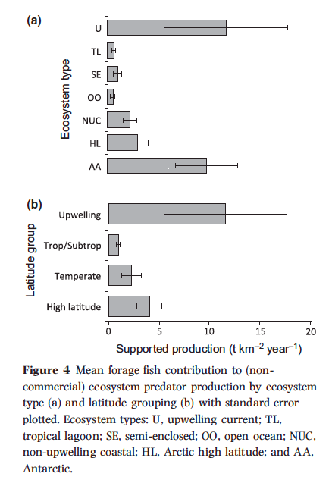

Slide 46
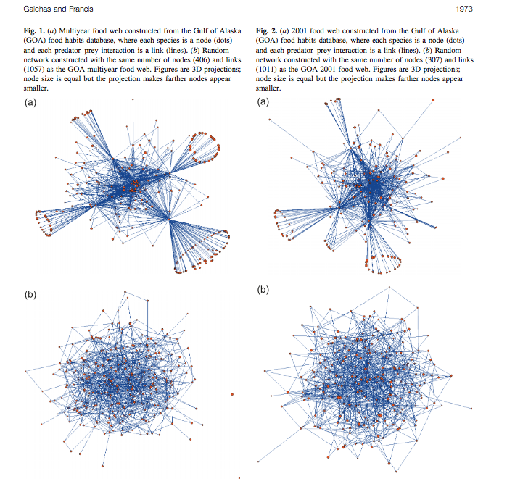
Can. J. Fish. Aquat. Sci. 65: 1965–1982 (2008)

Slide 47
Handling uncertainty in ecosystem models
Problems with classical treatment of parameter uncertainty
Ecosystem models typically have many more parameters than single-species models
High-dimensional parameter space
Can be computationally expensive to run

Slide 48
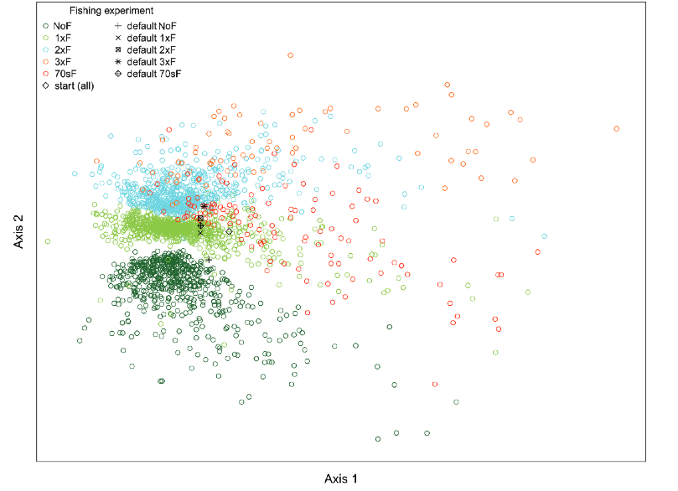
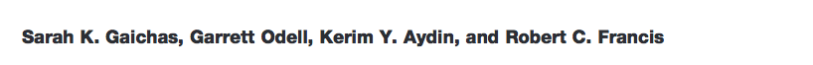
Addressing parameter uncertainty Monte Carlo simulations of possible ecosystems Viable systems showed robustness in ecosystem structure
Can. J. Fish. Aquat. Sci. 69: 2077–2094 (2012)

Slide 49
Handling uncertainty in ecosystem models
Problems with classical treatment of parameter uncertainty
Ecosystem models typically have many more parameters than single-species models
High-dimensional parameter space
Can be computationally expensive
Structural uncertainty
How to link system components
What functional forms to choose for relationships
Which system components to choose?
Now mostly being addressed through multimodel inference / ensemble modeling

Slide 50
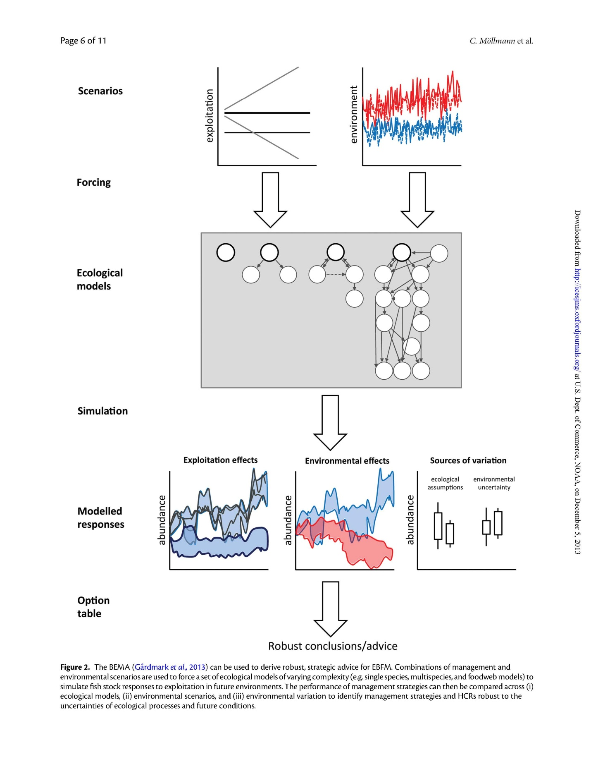
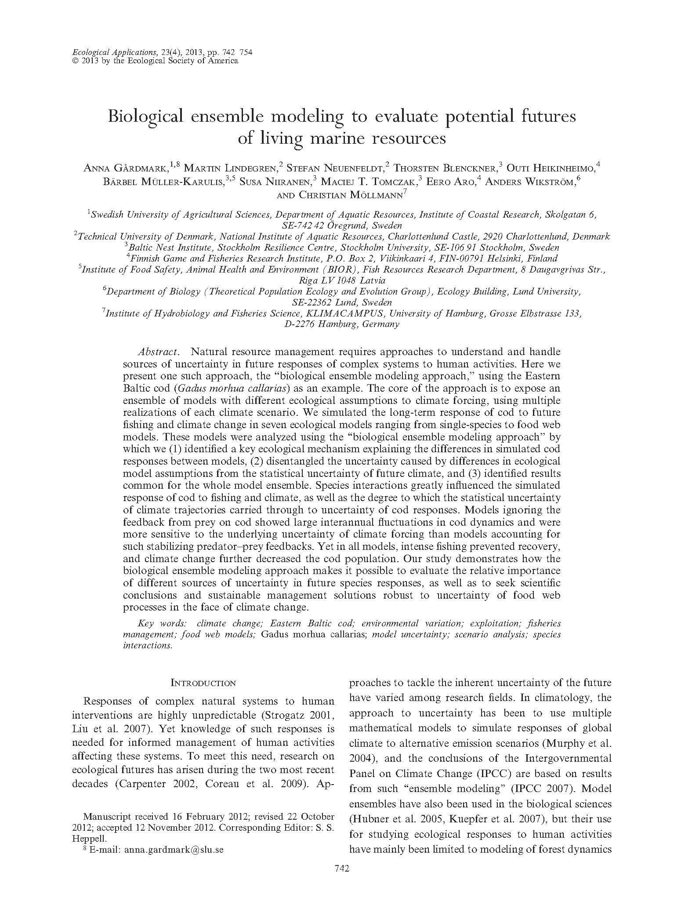
Ensemble modeling approach
Identifying robust advice
Compare management performance of different structural ecological models across environmental scenarios.
See also:
Mollmann et al. 2013. Figure 2.

Slide 51
Best practices in model development (FAO 2007, Fulton 2010)
Only include components needed for capturing critical dynamics
Important to explicitly include feedbacks
Address uncertainty: parameterization, model structure, associated requirements to try multiple management options
Across all the dimensions of model construction do not to default to the finest scales, often inappropriate and unnecessary.
Spatial and temporal resolution
Taxonomic resolution
Process resolution and external forcing
Anthropogenic components
Multiple model forms should be considered. There is no one “right” model

Slide 52
Weaknesses of approach
Large data demands
Documentation of models is daunting
Challenging to use
Experience and training needed both building and using
Nonstationarity

Slide 53
Key takeaways
There are lots of models to use in fisheries
Aggregate models can be used for strategic and tactical purposes.
Primarily strategic uses of ecosystem model outputs
End-to-end models are most effectively used strategically as ‘what-if’ tools (e.g. MSE approach).
Thought and tinkering is valuable — try different kinds of models, assumptions and formulations.
There is no one “right” model to use, multi-model inference is preferable, maintain flexible approach to implementation.
Systems models are much more involved than typical stock assessment models

Slide 54
What do we need?
INFORMATION / RESEARCH:
More diet, consumption, vital rates, etc. information
Better links between environment and vital rates.
Fuller understanding of influences of drivers on system, and human behavior & responses to management activity
Better parameterization and user-friendly development
More case studies of applications
Better fitting diagnostics and tools to incorporate multiple data
Output visualization
Methods to assess uncertainty in ways that are useful
PROCESS:
Venue for strategic research advice
How to incorporate as operating model in MSE-like processes
“Letting go” of stock as foci

Slide 55
Doing EBFM
Questions?

Slide 56
What’s Next?
Ecological Risk Assessment
Discussion on:
Fletcher 2005
Smith et al. 2007
Levin et al. 2009
Hobday et al. 2011

